Slide 1
Learning intention
To Learn about the stave and music notation To be able to read and clap accurately crotchets, quavers and rests To be able to play the note ‘B’ on the recorder correctly whilst reading simple music notation

Slide 2

Pirates of the Caribbean https://www.youtube.com/watch?v=clR1q614XS8

Slide 3
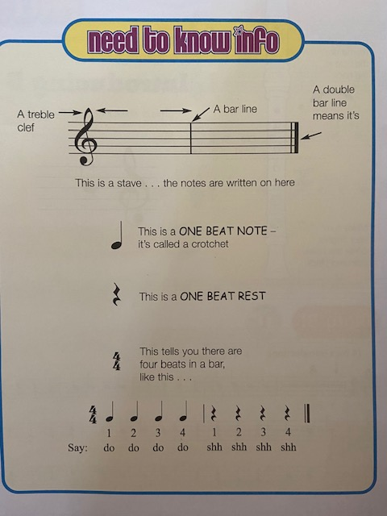
The Stave

Slide 4
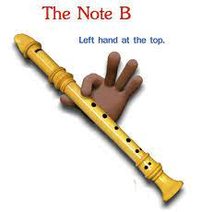
Introducing B
Put your left hand on the hole at the back
Put your first finger on the first hole at the front

Slide 5
Common Mistakes
• Make sure the 3 parts of the recorder are lined up correctly! The finger holes should line up with the mouth piece window.
• Leaking fingers – ensure you have covered the holes completely.
• Bad posture.
• Do not use a new breath for every note! Use a steady stream of air - the tongue stops and starts the note.

Slide 6
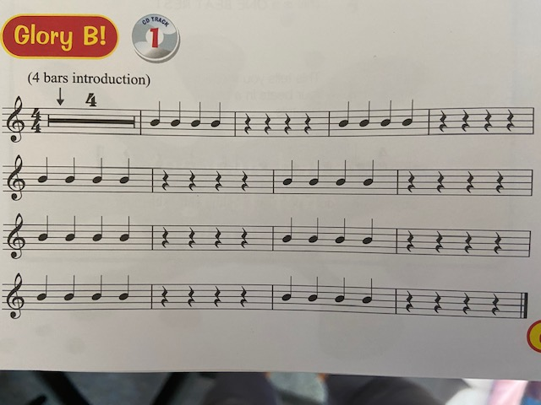
First Finger B

Slide 7
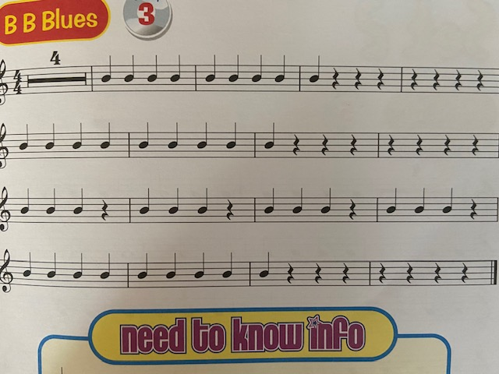
BB Blues

Slide 8
Learning Intention
To hold the recorder correctly
To be able read and understand rhythmic notation
To be able to recognise the notes A and B on the stave
To be able to confidently play notes A and B
To be able to play the recorder with controlled a breath
To begin to be able to change fluently between A and B

Slide 9
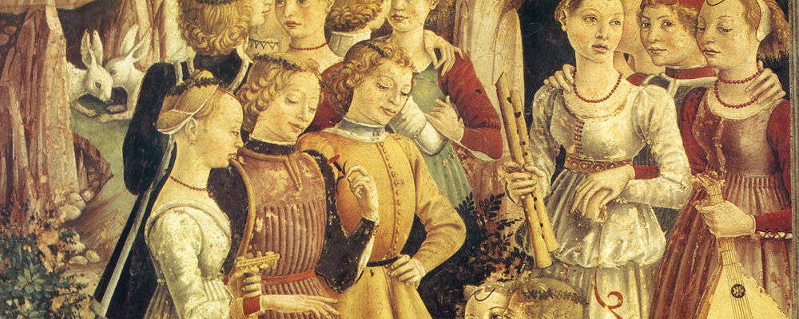
History of The Recorder,
The first recorders were made in the 1500s They became popular in Europe during the Middle Ages. ... From the second half of the 15th century to the 17th century it was frequently seen in lively performances.

Slide 10
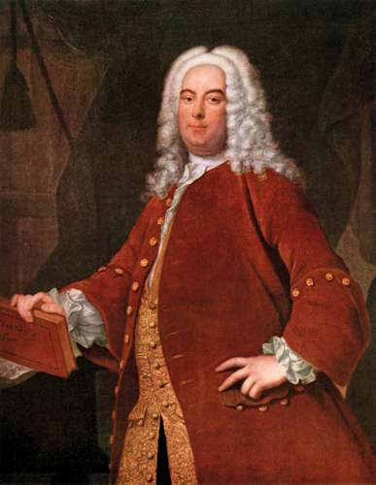
Arrival of the Queen of Sheba https://www.youtube.com/watch?v=_AJMrub11Lk
George Frederick Handel February 23, 1685 - April 14, 1759 Baroque Period Born in Germany

Slide 11
Learning Intention
To hold the recorder correctly
To be able to play the recorder with controlled a breath
To be able read and understand rhythmic notation
To be able to recognise the notes A , B and G on the stave
To be able to begin to play the note G
To begin to be able to change fluently between A , B and G

Slide 12
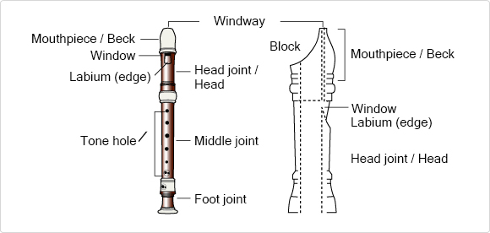
Parts of the Recorder

Slide 13
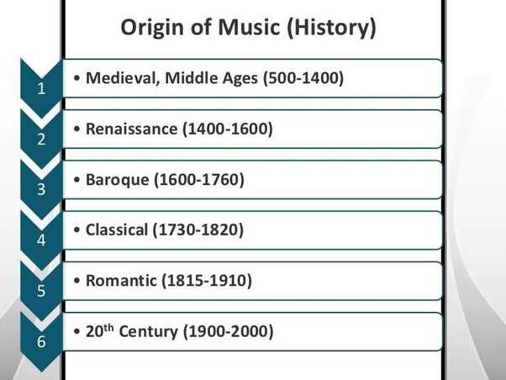
Time Periods in classical music
Music for a Bird Linde 1936 https://www.youtube.com/watch?v=akS05RSnlMU
Harpsichord and recorder https://www.youtube.com/watch?v=sRsdeyWBfqc

Slide 14
Charlotte Barbour-Condini - BBC Young Musician 2012 - Recorder - Music for a Bird
https://www.youtube.com/watch?v=akS05RSnlMU
Modern Music (20th century onwards)
Mixture of long low sounds and high quick sounds
What bird does it remind you of?
What does she do with her right hand?
Can you hear the split notes?

Slide 15
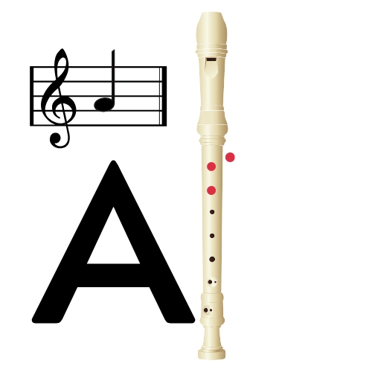
The note A

Slide 16
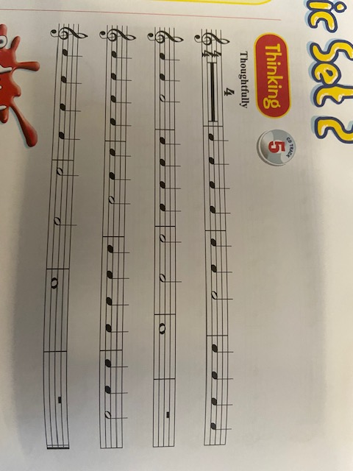
Learning A

Slide 17
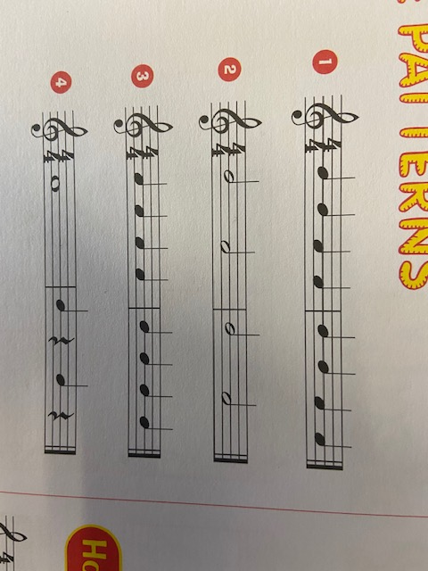
Using A and B

Slide 18
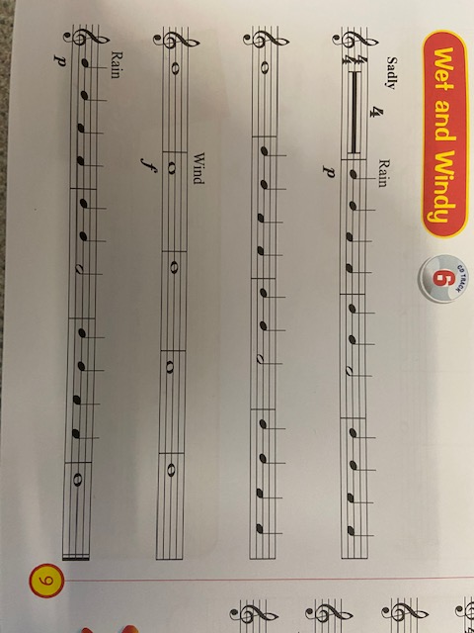
Wet and windy

Slide 19
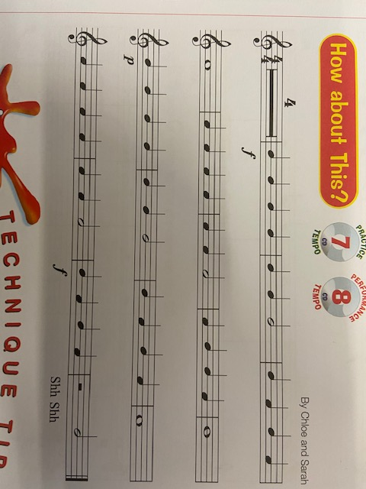
How About This

Slide 20
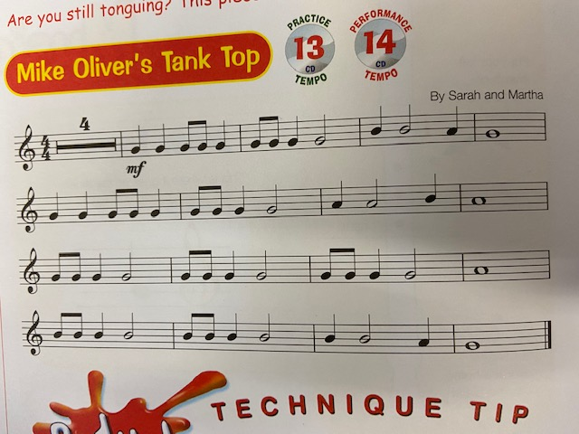

Slide 21
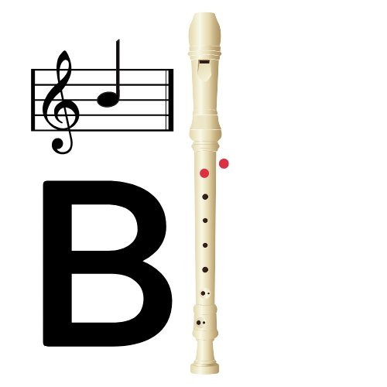
You play B with your thumb and first finger

Slide 22
The note A
You play A with your thumb 1st and 2nd finger

Slide 23
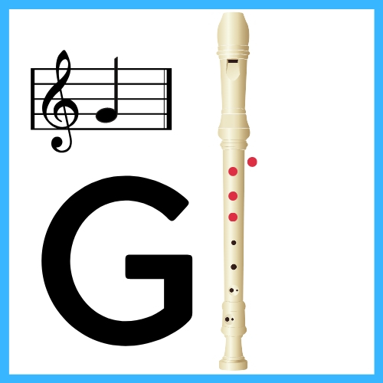
You play G with your thumb 1st, 2nd and 3rd finger
Now play ‘Learning G’

Slide 24
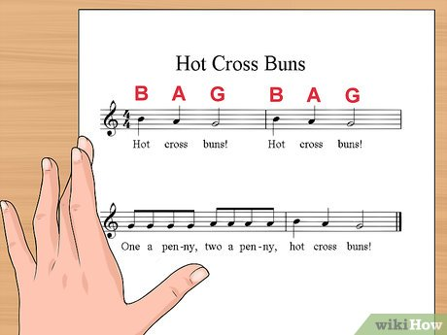

Slide 25
Au Clair de la Lune
Au clair de la Lune mon ami Pierrot
Prète moi ta plume pour écrire un mot,
Ma chan-delle est morte jen’ai plus de feu,
Ouvre moi ta porte pour l’amour de dieu.

Slide 26
Translation
At your door I’m knocking, by the pale moonlight,
Lend a pen, I beg you, I’ve a word to write.
Out has gone my candle, my fire burns no more,
For the love of heaven, open up the door!

Slide 27
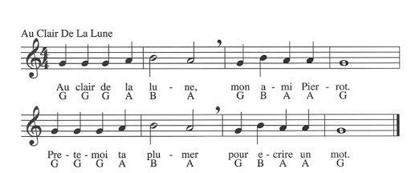
Au Clair De La Lune

Slide 28
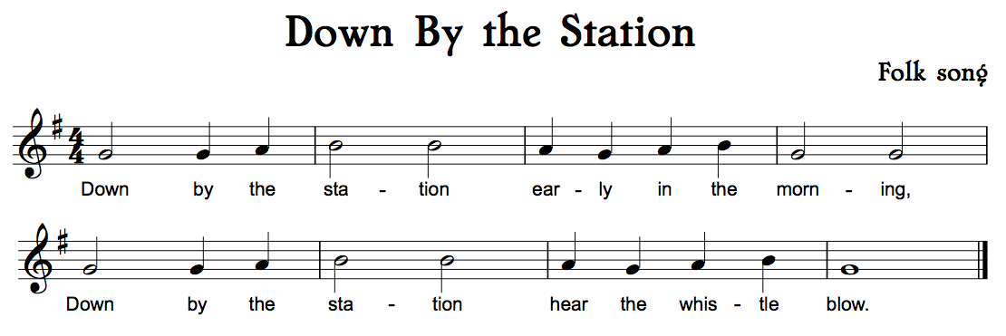
Down by the Station

Slide 29
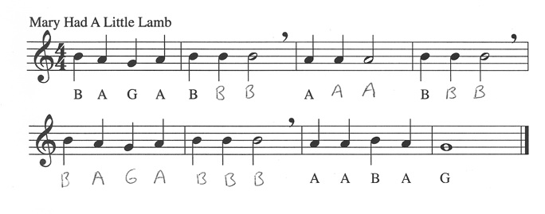
Mary had a Little Lamb

Slide 30
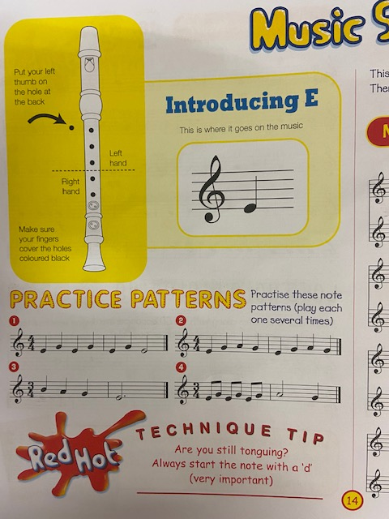

Slide 31
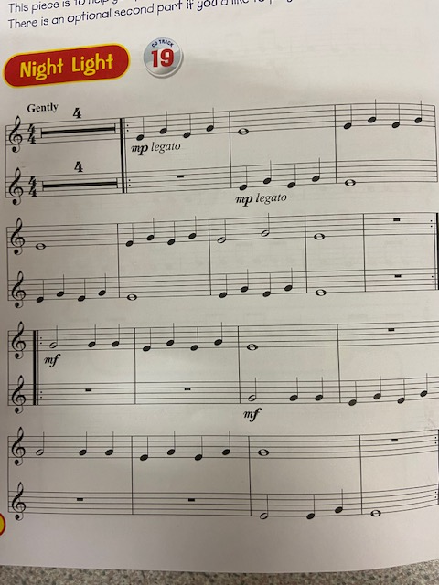

Slide 32
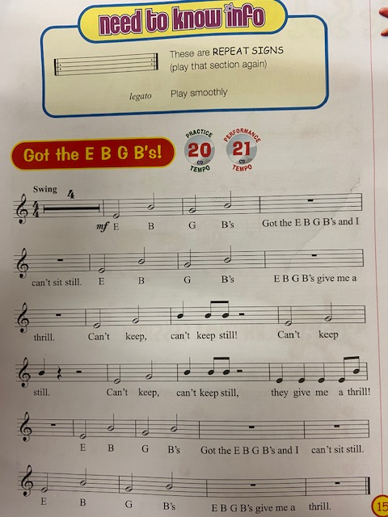

Slide 33
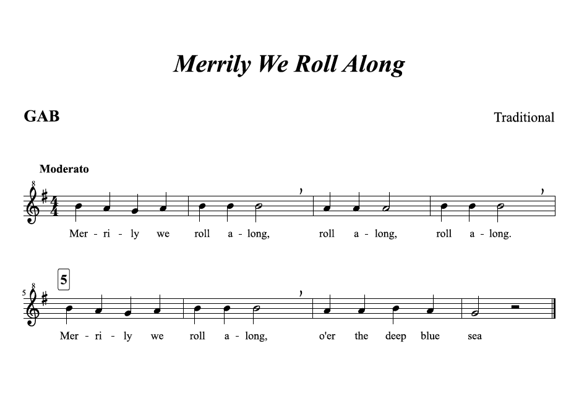

Slide 34
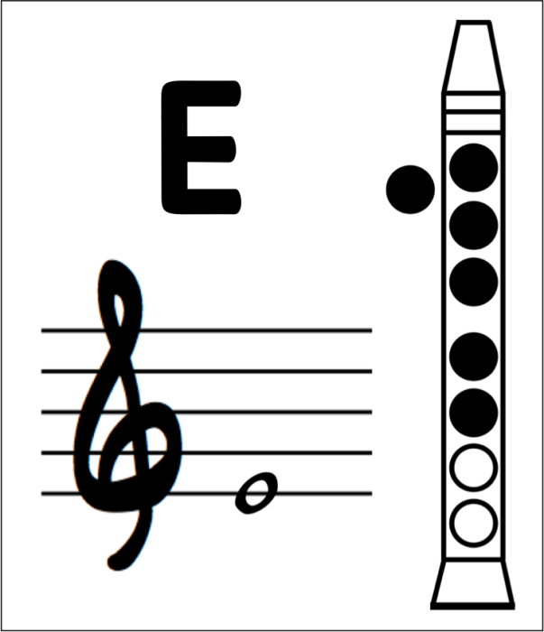

Slide 36
The note A
You play A with your thumb 1st and 2nd finger

Slide 37
You play B with your thumb and first finger

Slide 38
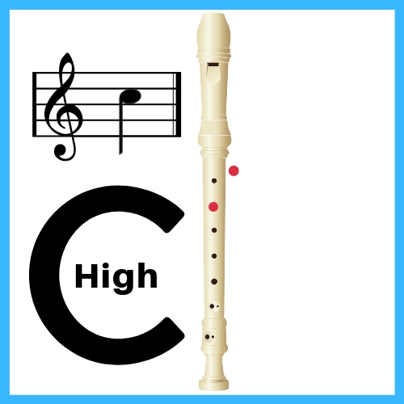

Slide 39
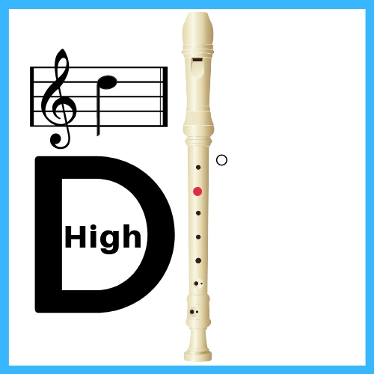

Slide 40


