Slide 1
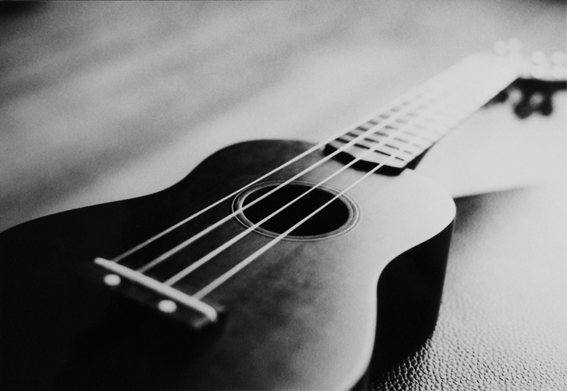
How to play the Ukulele

Slide 2
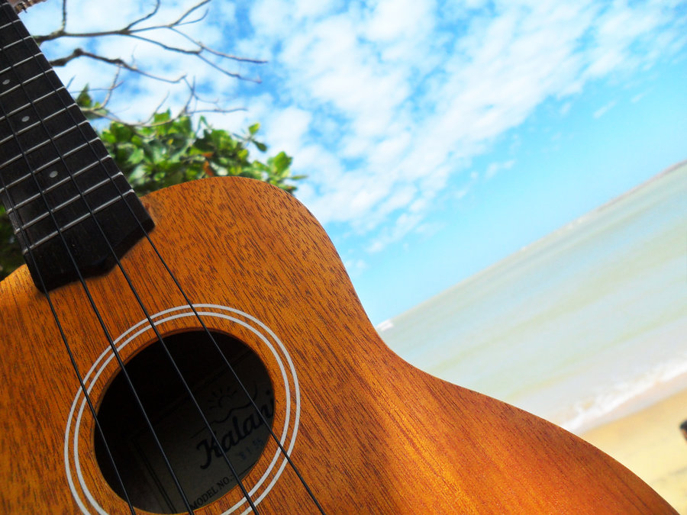

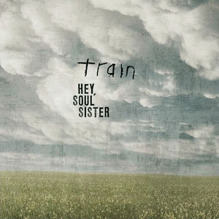

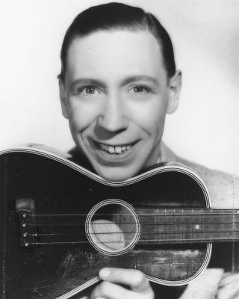


Have you heard the Ukulele before?
Train 'Hey, Soul Sister' Billboard Live Acoustic Studio Session - YouTube
OFFICIAL Somewhere over the Rainbow - Israel "IZ" Kamakawiwoʻole - Bing video

Slide 3


Hawaii

Slide 4
The Ukulele originates from Hawaii in
the 19th century where it was developed
from two small Portugese guitars,.
The name, Ukulele roughly translates as
'jumping flea!!'. This name may have come from
the fast and fidgety way the fingers run over the
frets. However, according to the last Queen of
Hawaii, the name means 'the gift that came here',
'uku' meaning the gift or reward, and 'lele', to come.
In the 20th century the ukulele became very
popular in America and has since grown
In popularity all over the world.

Slide 5
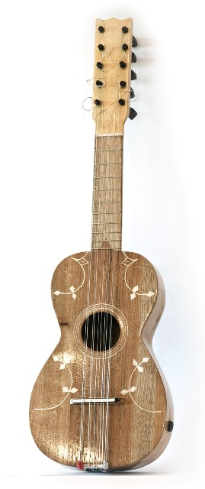
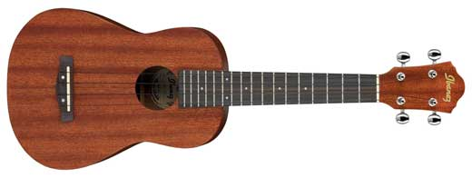
Machete
(from Portugal)
Ukulele

Slide 6
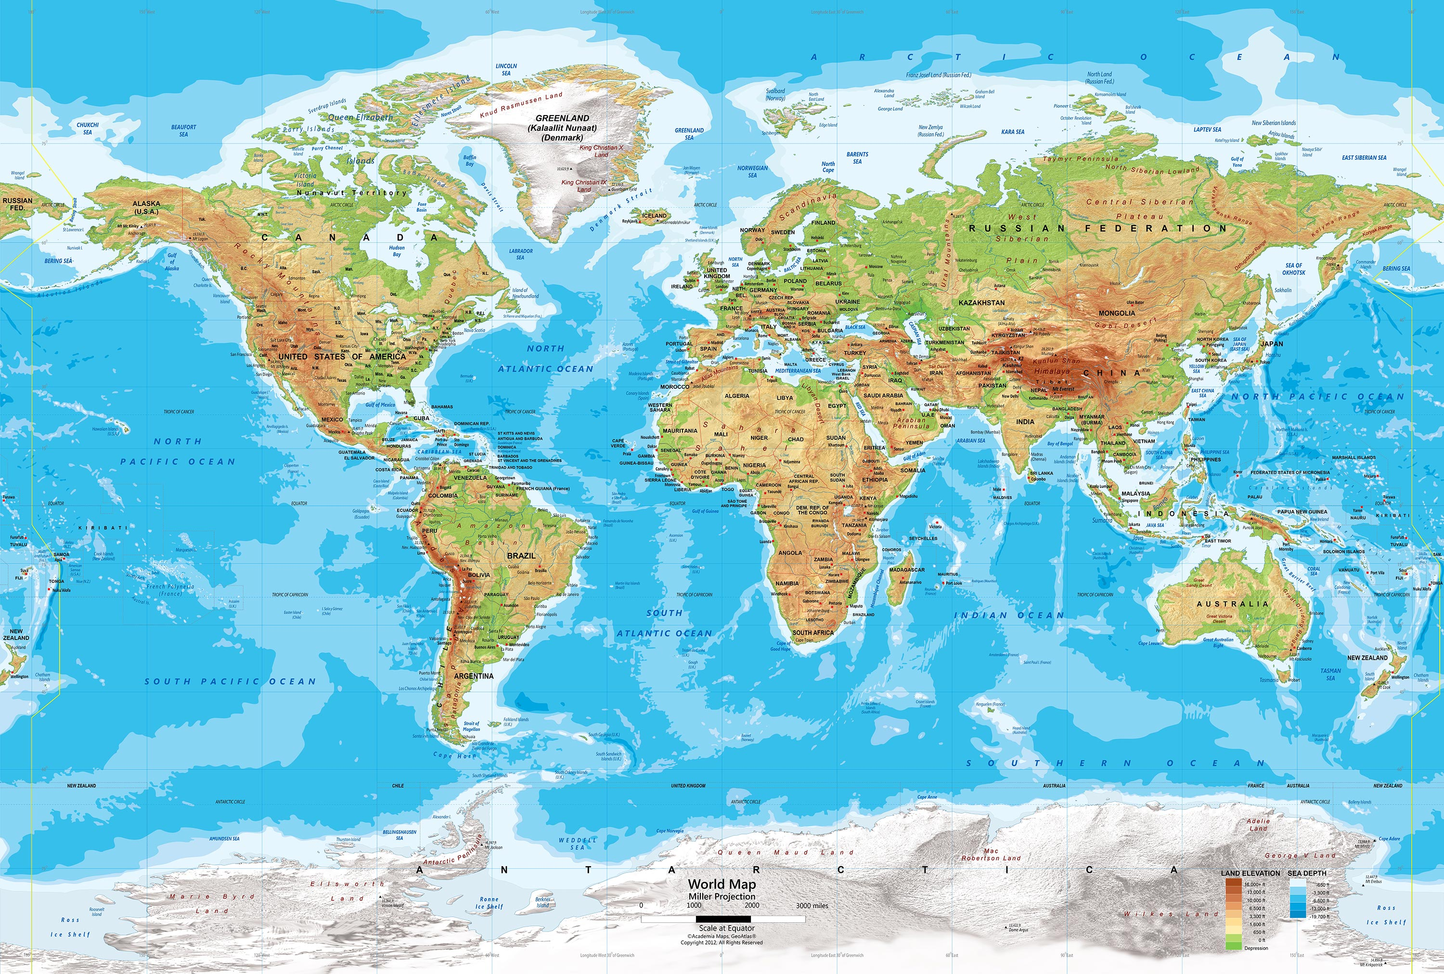
Where does the Ukulele come from?
Hawaii
Madeira
Cape Verde

Slide 7
Ukuleles are traditionally made from wood,
Although cheaper varieties are made from
plastic, plywood, or other materials. Some of
The most expensive ukuleles, which may cost
Thousands of pounds are made from wood
From Hawaii, 'koa' (acacia koa).
Generally the ukulele has four strings, although
Some variants may have 6 or 8.
There are four different sizes of ukulele, the
soprano, concert, tenor and baritone. The
soprano is the smallest and original size and
This is the size that we have here in school.

Slide 8
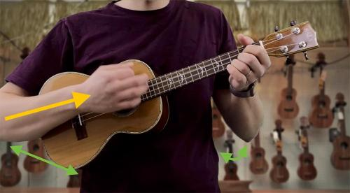
How to hold the Ukulele

Slide 9
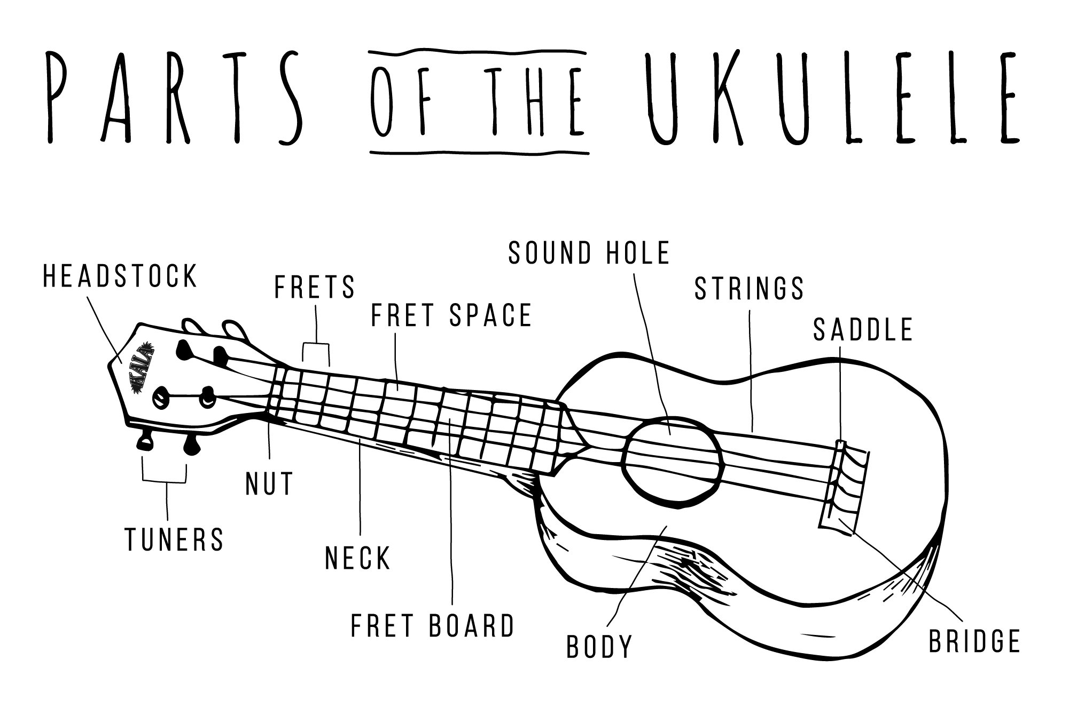

Slide 10
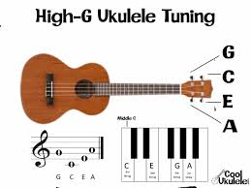

Slide 11
The four strings are tuned as follows:-
G, C, E, A
You can remember it as Good Children
Eat Apples, but maybe you can think of
a much better way of remembering this
acronym. Discuss some possibilities
with the person next to you.
Now let's learn to play the UKULELE!

Slide 12
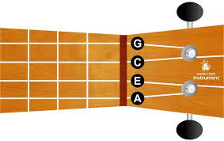
Ukulele strings

Slide 13

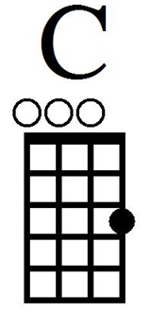
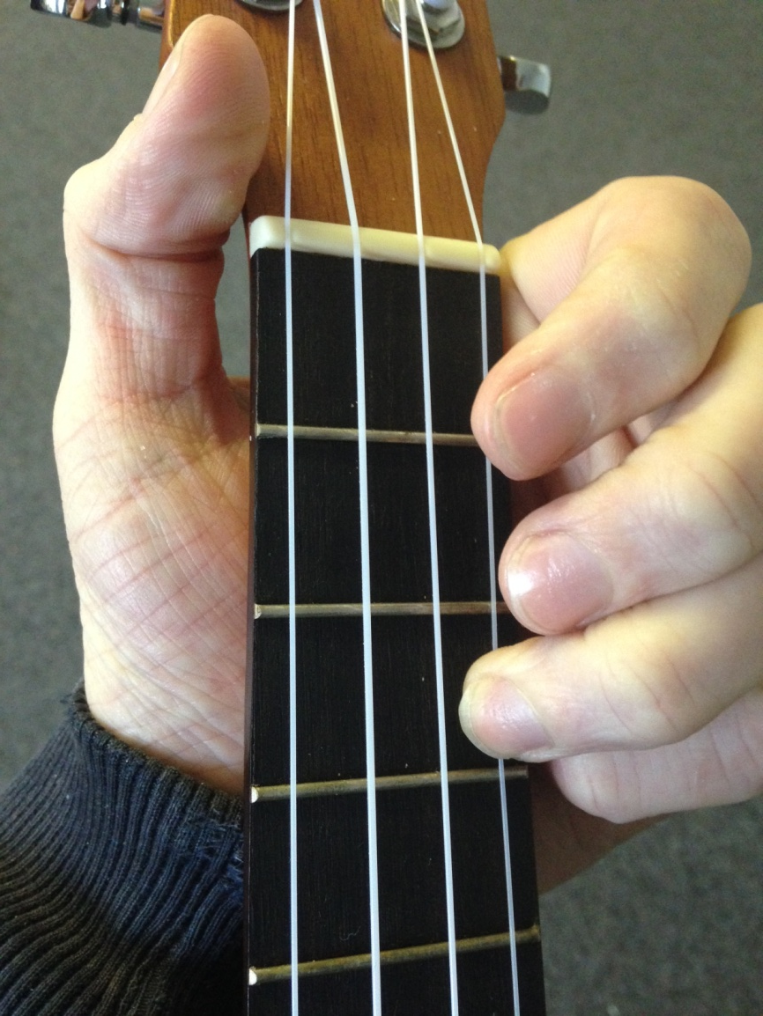
Chord of C

Slide 14
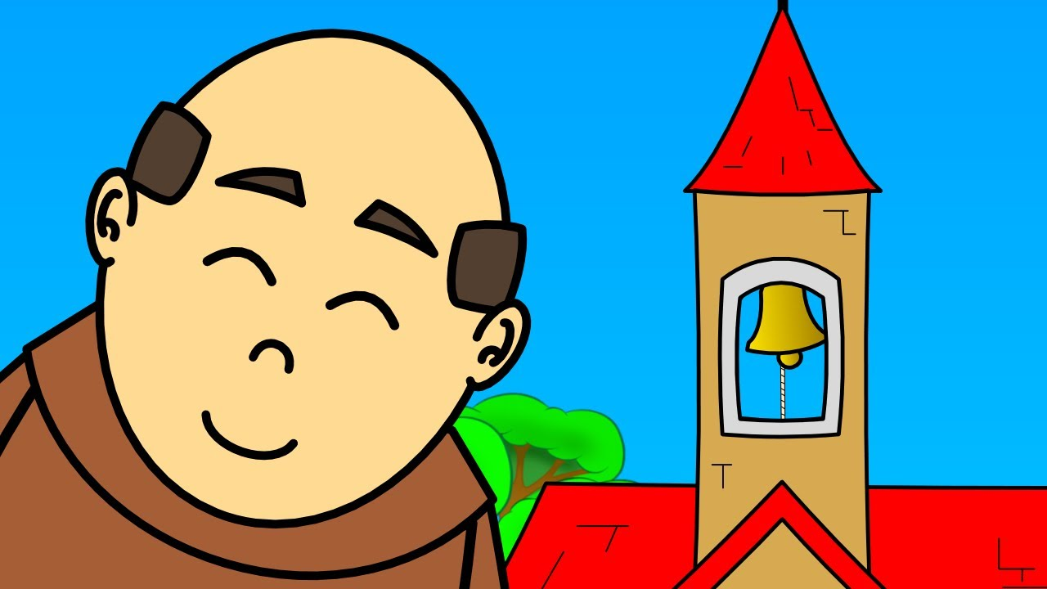
Frere Jacque
C C C C
Frère Jacques, Frère Jacques,
C C C C
Dormez-vous? Dormez-vous?
C C C C
Sonnez les matines, sonnez les matines
C C C C
Ding dang dong, ding dang dong

Slide 15

London’s burning
C C C C C C
London’s burning, London’s burning,
C C C C C C
Fetch the engine, fetch the engine
C C C C C C
Fire! Fire! Fire! Fire!
C C C C C C
Pour on water, pour on water

Slide 16
Common Mistakes
Make sure your finger is on the string not in between the strings
Make sure you use the correct finger
Press hard on the string to make it ring
Bend your fingers
Strum over the finger board

Slide 17
Write your own song!
C C C C
C C C C
C C C C
C C C C

Slide 18
Mrs Lloyd’s Happy Song
I play the Ukulele
It’s a happy time
I play the Ukulele
I play it all of the time
Now write your own 4 line song using just the C chord

Slide 19
RULES
DO NOT TOUCH THE TUNNING PEGS!

Slide 20
Learning Intention
To be able to sing the Chorus to Bob Marley’s ‘Three little Birds’
To be able to form the Chord shapes for C Chord and F Chord
To begin to be able to change between the chord of C and F
To learn the new chord A minor

Slide 21
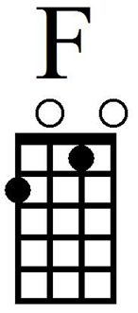
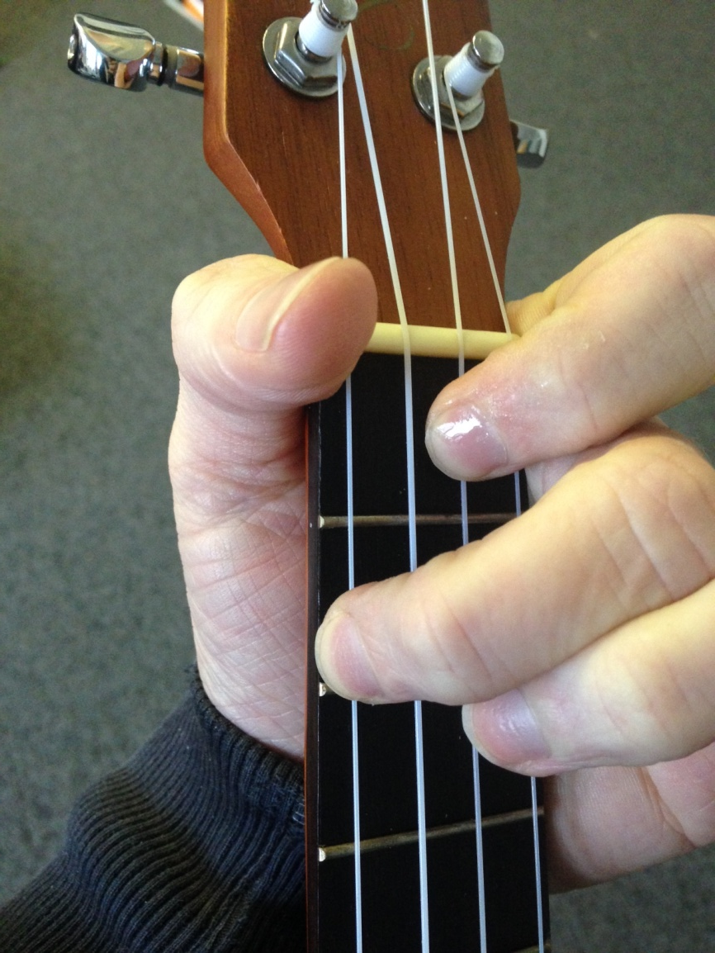
Chord of F

Slide 22
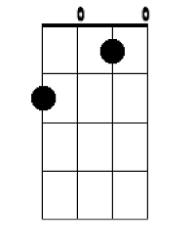

Chord of F
Reading Tab

Slide 23
Chords C & F

Slide 24
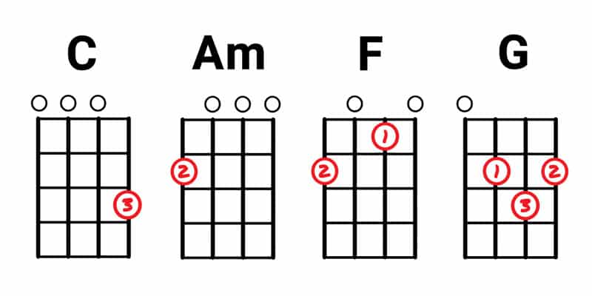
4 new chords

Slide 25
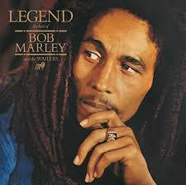

Slide 26

Three Little Birds
C C C C
Don’t worry,
C C C C
about a thing cos’
F F F
Every little thing,
F C C C C
gonna be alright

Slide 27
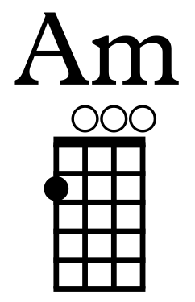
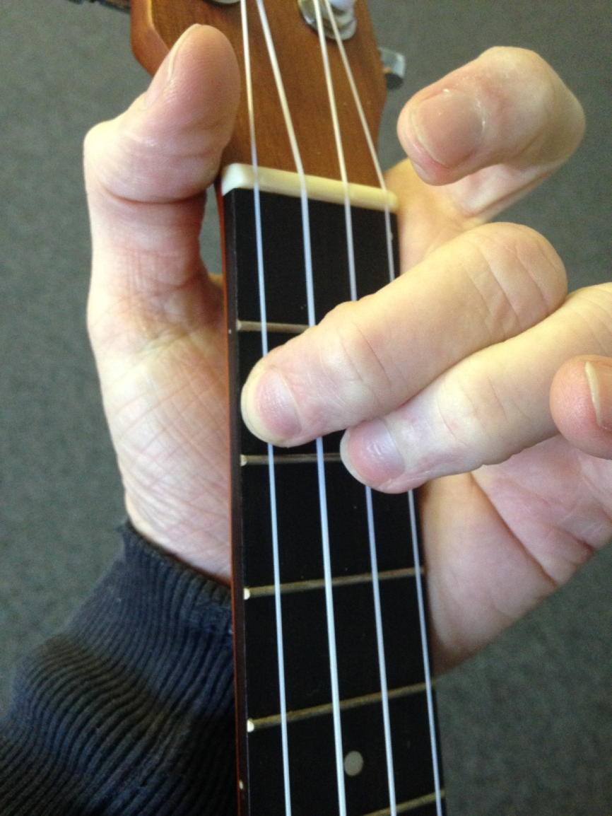
Chord of Am

Slide 28
Get up, stand up
Get up stand up
Stand up for your right
Get up stand up
Don’t give up the fight

Slide 30


Katy Perry - Roar
Slow
Fast
C C C C
I used to bite my tongue and hold my breath
C C C C
Scared to rock the boat and make a mess
Am x4 F x4
So I sat quietly, agreed politely
C C C C
I guess that I forgot I had a choice
C C C C
I let you push me past the breaking point
Am x4 F x4
I stood for nothing, so I fell for everything
Notes:
2 bar piano intro

Slide 31
C C C C
You held me down, but I got up
C C C C
Already brushing off the dust
Amx4
You hear my voice, you hear that sound
F x4
Like thunder, gonna shake the ground
C C C C
You held me down, but I got up
C C C C
Get ready cause I've had enough
Am x4
I see it all, I see it now
F x4
I got the eye of the

Slide 32
C x8
Tiger, the fighter, Dancing through the fire
Am x4
Cause I am a champion and
F x4
You're gonna hear me
C x8
Roar, louder, louder than a lion
Am x4
‘Cause I am a champion and
F x4
You're gonna hear me roar
C x8
Oh oh oh... oh oh __, Oh oh oh oh oh...,
Am x4 F x4
Oh oh oh... You're gonna hear me roar

Slide 33
Learning Intention
To be able to sing the song ‘Drunken Sailor’
To understand what a chord is
To be able to change between the chords of D minor and C major
To begin thinking of different strumming patterns
To begin to be able sing and play the song ‘Drunken Sailor’ using the chords of D Minor and C major

Slide 34

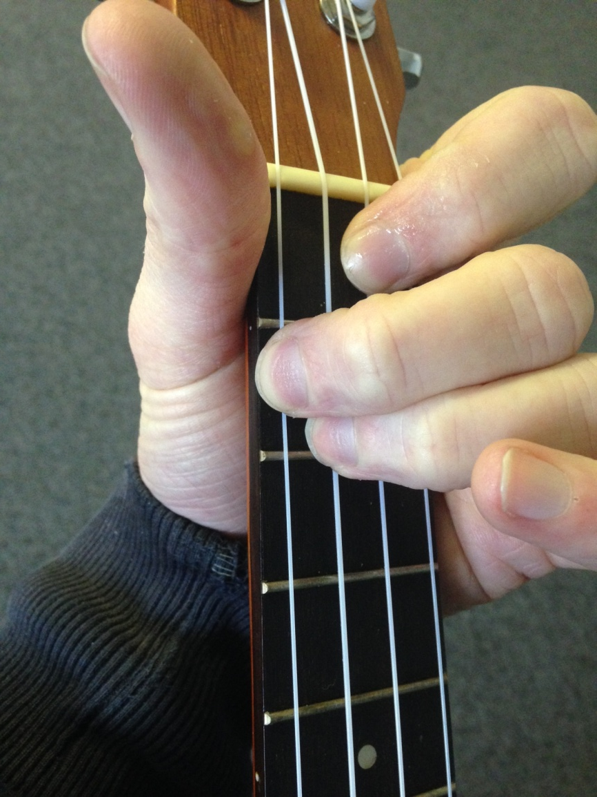
Chord of Dm

Slide 35
Chords C & Dm

Slide 36
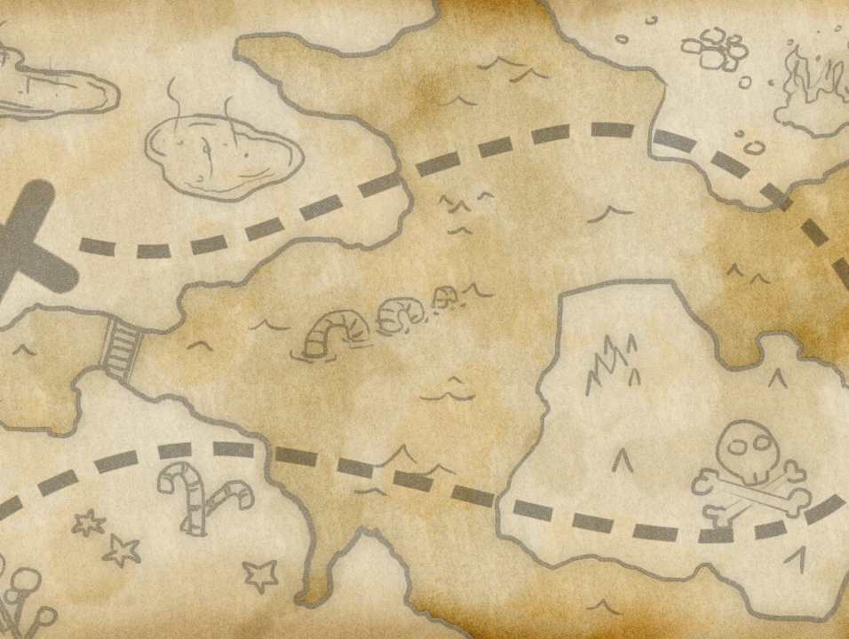
Drunken Sailor
Dm x4
What will we do with the drunken sailor?
C x4
What will we do with the drunken sailor?
Dm x4
What will we do with the drunken sailor?
C x2 Dm x2
Earl-aye in the morning?
Way, hey and up she rises
Way, hey and up she rises
Way, hey and up she rises
Earl-aye in the morning
Notes:
2 bar intro

Slide 37
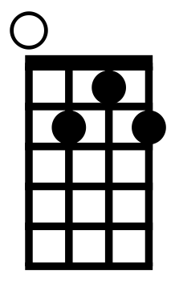
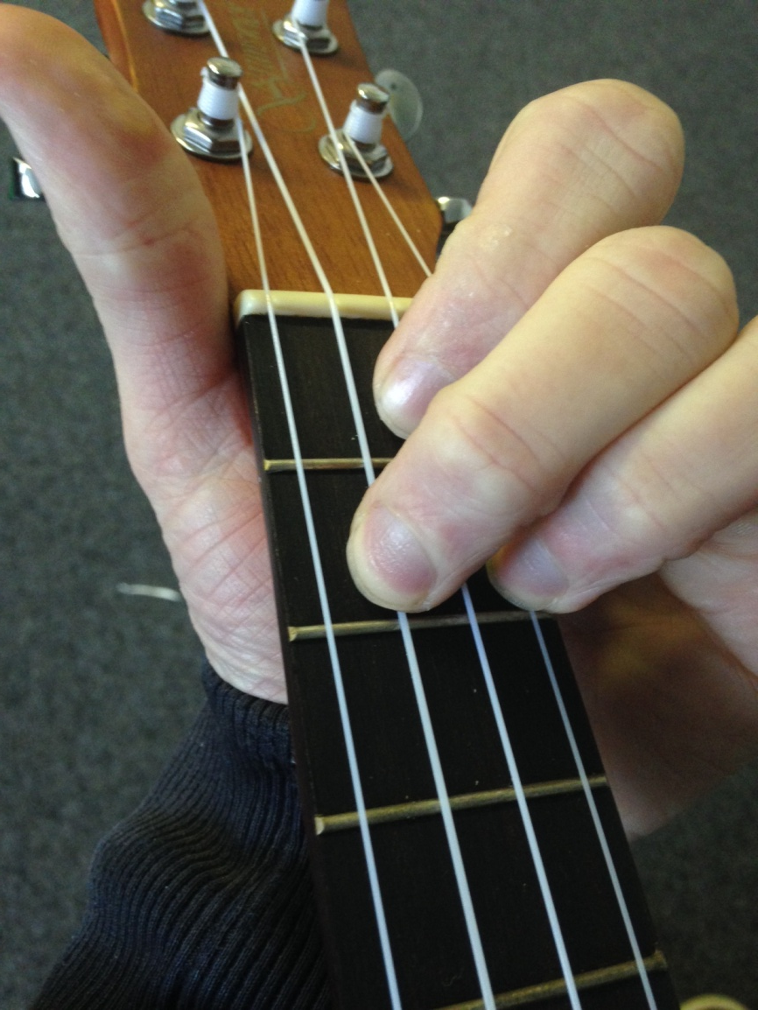
Chord of G7

Slide 38
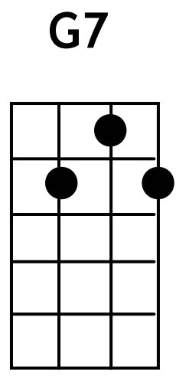
Chords C & G7

Slide 39
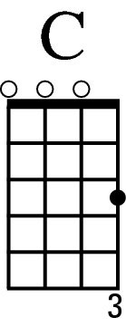
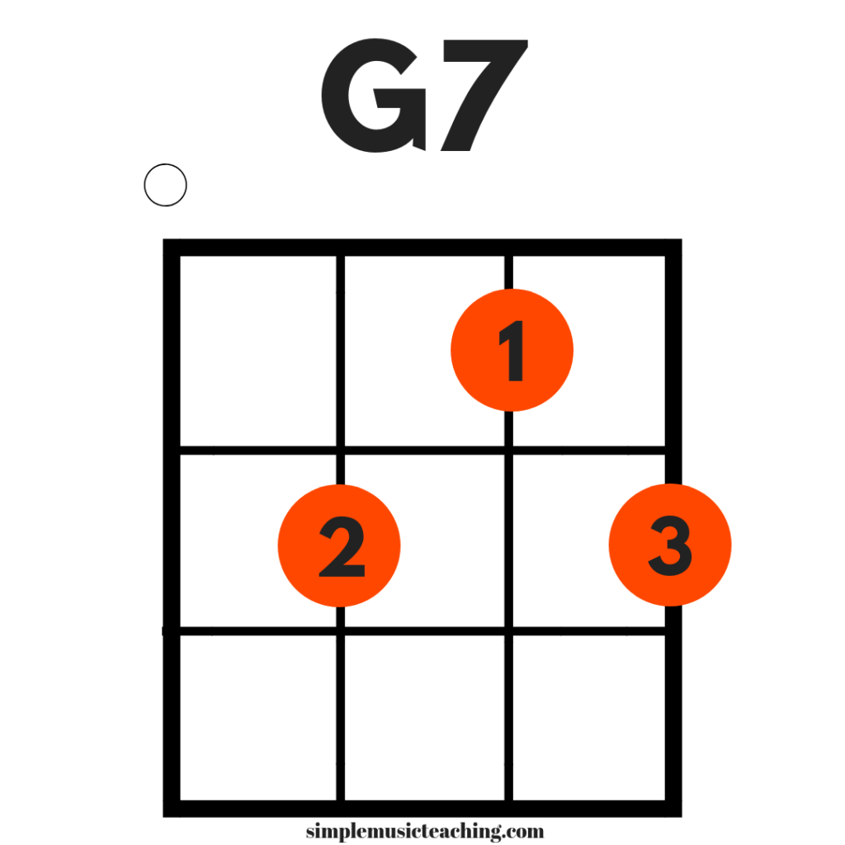
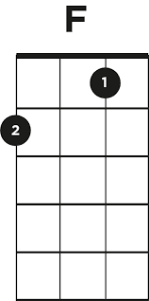

Slide 41
Three chords
G7
x8

Slide 42
3 chords

Slide 43
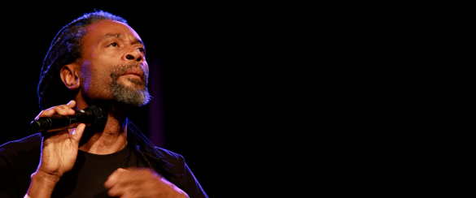
Don’t worry, be happy
Here’s a little song I wrote
You might want to sing it note for note
Don't worry, be happy
In every life we have some trouble
When you worry you make it double
Don't worry, be happy
Oooooooo, ooooo, oooo etc
Ain't got no cash, ain't got no style
Ain't got no girl to make you smile
But don't worry be happy
Cause when you worry, your face will frown
And that will bring everybody down
So don't worry, be happy
Oooooooo, ooooo, oooo etc
x 4
x 4
x 4
x 4

Slide 44
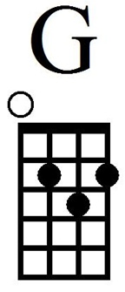
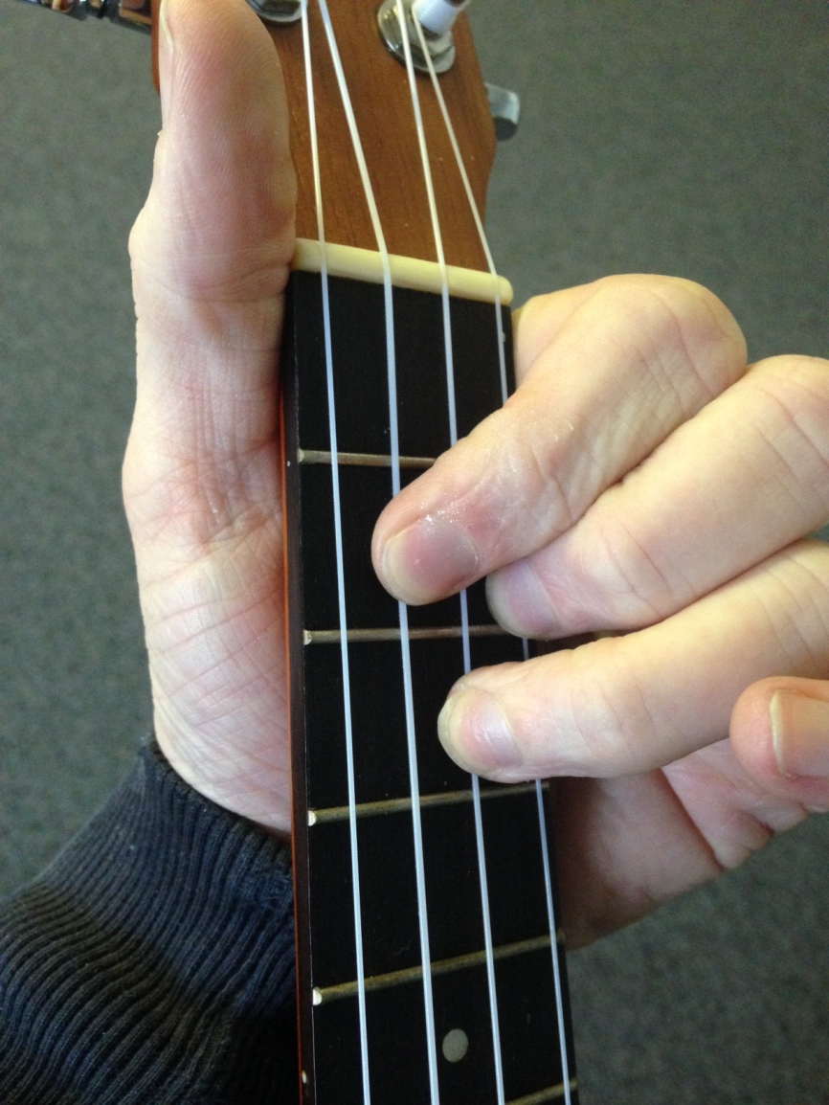
Chord of G
Or yellow!!

Slide 45
Chords C & G

Slide 46
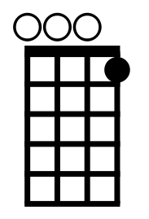
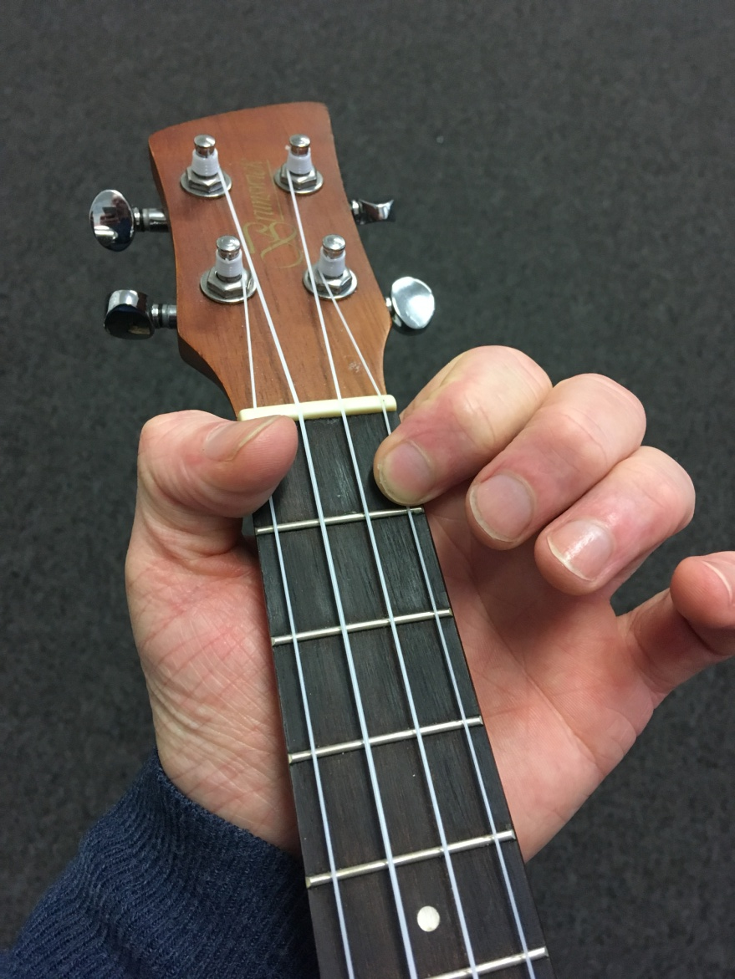
Chord of C7

Slide 47

Rockin Robin
Slow
Fast
C7 (x13)
He rocks in the tree tops all day long
Hoppin’ and a boppin’ and singing his song
All the little birdies on Jaybird street
Love to hear the robin go tweet tweet tweet
F (x4)
Rockin’ robin, rock rock
C7 (x4)
Rockin’ robin, rock rock
G (x1)
Blow rockin’ robin
F (x1) C7 (x4)
‘Cause we’re really gonna rock tonight
Notes:
8 bar intro – STOP on Love (continue on F)

Slide 48
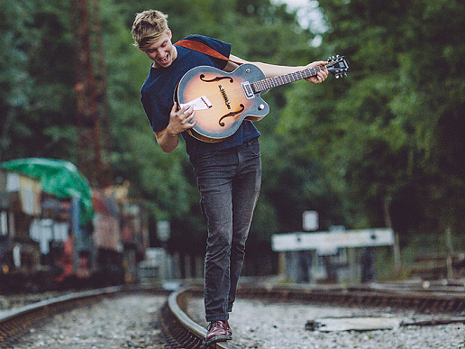

Shotgun
C x4 F x4 Am x4 G x4
Home grown alligator, see you later, gotta hit the road, gotta hit the road
C x4 F x4
The sun it changed in the atmosphere, architecture unfamiliar
Am x4 G x4
I could get used to this
C x4 F x4 Am x4 G x4
Time flies by in the yellow and green, stick around and you’ll see what I mean
C x4 F x4
There’s a mountain top, that’s I’m dreaming of,
Am x4 G x4
If you need me you know where I’ll be
C x4 F x4 Am x4 G x4
I’ll be riding shotgun underneath the hot sun, feeling like a someone
C x4 F x4 Am x4 G x4
I’ll be riding shotgun underneath the hot sun, feeling like a someone
C C
I’ll be riding shotgun
Notes:
4 Bar Intro

Slide 49
Blue suede shoes
C
Well, it's one for the money
C
Two for the show
C
Three to get ready
C7 C7 C7
Now go, cat, go
F (x4)
But don't you
C (x4)
Step on my blue suede shoes
G (x2)
You can do anything
F (x2) C
But stay off of my blue suede shoes

Slide 50
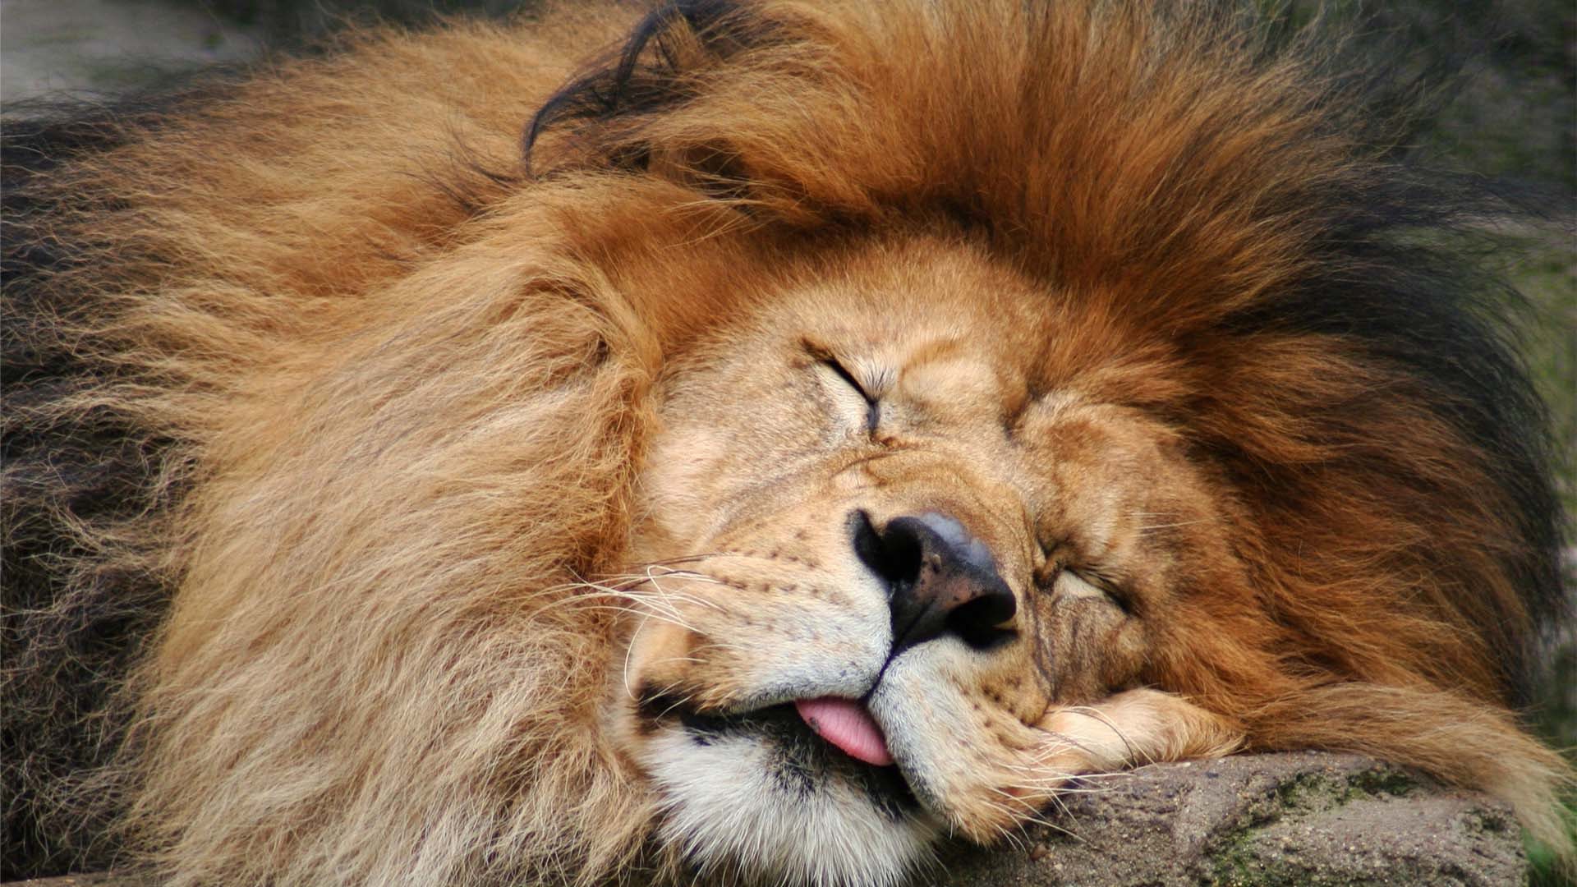

The lion sleeps tonight
Wimoweh etc.
In the jungle, the mighty jungle
The lion sleeps tonight
In the jungle, the quiet jungle
The lion sleeps tonight
Near the village, the peaceful village
The lion sleeps tonight
Near the village, the quiet village
the lion sleeps tonight
x4
x4
x4
x4

Slide 51

Riptide – Vance Joy
I was scared of dentists and the dark
I was scared of pretty girls and starting coversations
Oh all my friends are turning green
You’re the magicians assistant in their dreams
Ooh, ooh ooh
Ohh, and they come unstuck
Lady, running down to the riptide,
Taken away to the dark side
I wanna be your left hand man
I love you when you’re singing that song and
I got a lump in my throat ‘cause
You’re gonna sing the words wrong
There’s a movie that I think you’ll like
This guy decides to quit his job and heads to New York City
This cowboy’s running from himself
And she’s been living on the highest shelf
x 2
x 2
x 4

Slide 52
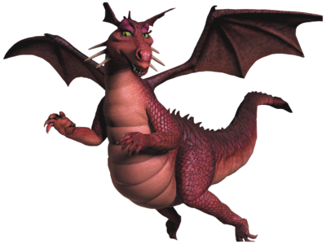
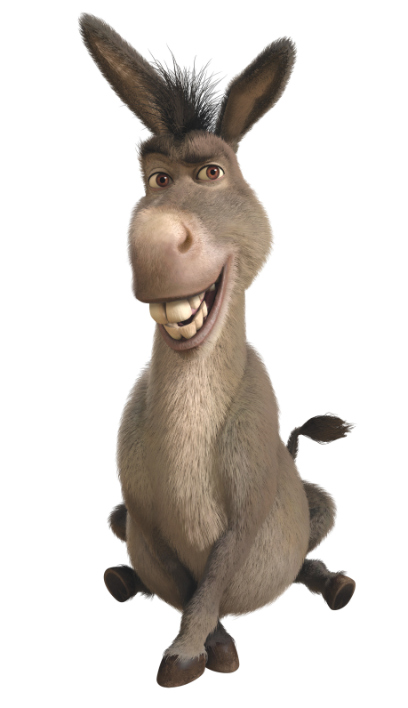
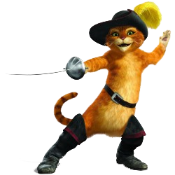
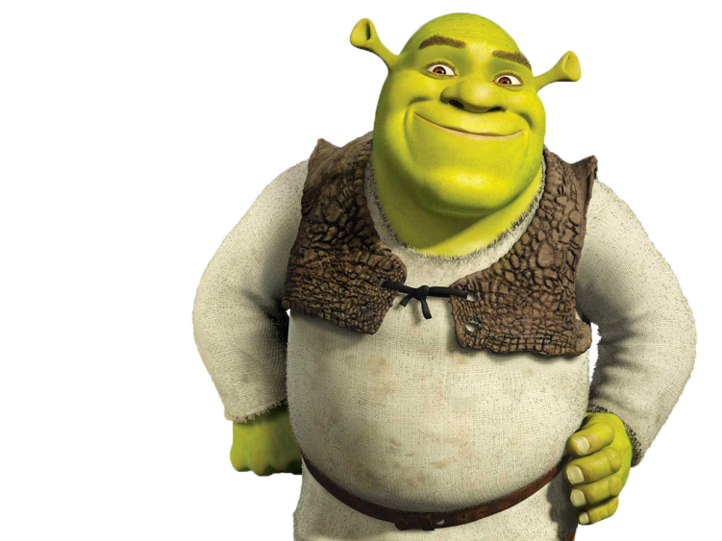
I’m a believer
C x2 G x2 C x4
I thought love was only true in fairy tales
C x2 G x2 C x4
Meant for someone else but not for me.
F x2 C x2
Love was out to get me
F x2 C x2
That's the way it seemed.
F x2 C x2 G x3
Disappointment haunted all my dreams.
C C F F C C F F C C F F C C F F
Then I saw her face, now I'm a believer
C C F F C C F F C C F F C C F F
Not a trace , of doubt in my mind.
C x1 F x1 C x4
I'm in love, (ooh) I'm a believer!
F x4 G x5
I couldn't leave her if I tried.

Slide 53
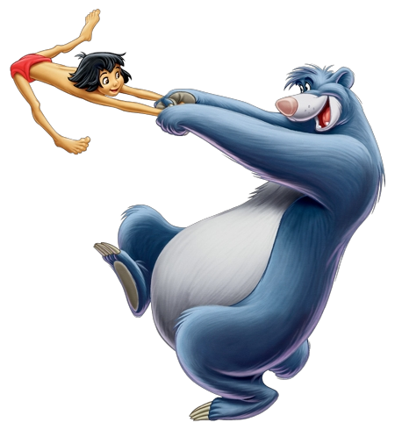
The Bare necessities
C x4
Look for the bare necessities
F x4
The simple bare necessities
Cx4 G x4
Forget about your worries and your strife
C x4
I mean the bare necessities
Fx4
Old mother nature's recipes
Cx2 Gx2 Cx4
That bring the bare necessities of life

Slide 54
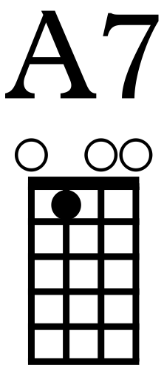
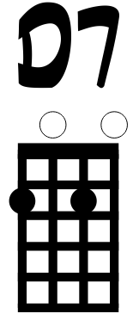
G x4 C x4
Wherever I wander, wherever I roam
G x4 C x4
I couldn't be fonder of my big home
F x4
The bees are buzzin' in the tree
C x2 D7 x2
To make some honey just for me
Am x1 A7 x1
When you look under the rocks and plants
F x2 G x2
And take a glance at the fancy ants
C x2 F x4
Then maybe try a few
F x2 G x2 C x2
The bare necessities of life will come to you
G x2 C
They'll come to you!

Slide 55
Chord of G7

Slide 56
Chords C & G7

Slide 57

Three chords
G7
x8
8 beat intro

Slide 58
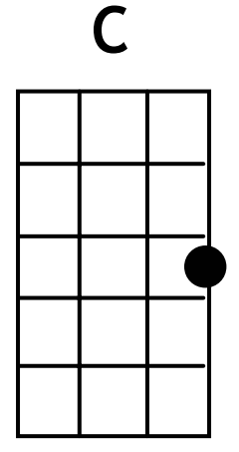
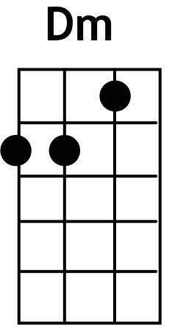
Summer jam

Slide 59
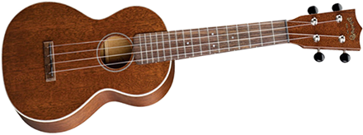
Four chords
G7
x8
8 beat intro

Slide 60

I’m yours – Jason Mraz
Well you done done me and you bet I felt it
I tried to be chill but you're so hot that I melted
I fell right through the cracks, now I'm trying to get back
Before the cool done run out, I'll be giving it my bestest
And nothing's going to stop me but divine intervention
I reckon it's again my turn to win some or learn some
I won't hesitate no more, no more
It cannot wait, I'm yours

Slide 61
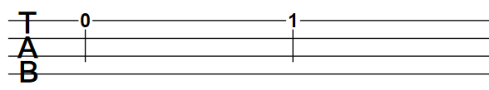
TAB
Open
1st Fret
Strings

Slide 62
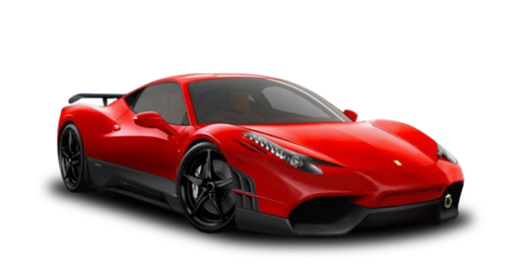

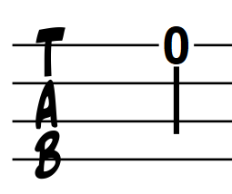
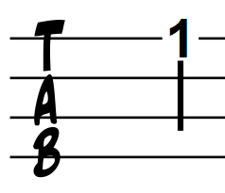


Tab game
String 1

Slide 63






Tab game
String 2

Slide 64


1.
New Chord!
C7
C7
2.
3.
C7
C7
C7

Slide 65


4.
5.
6.

Slide 66

First string groove

Slide 67


Second string groove

Slide 68


Uke can do it!

Slide 69


Swing that Uke!

Slide 70



Hot cross buns
Twinkle twinkle

Slide 71

Write your own

Slide 72

Funkulele

Slide 73
This old man

Slide 74

Super freak

Slide 75
5 years time

Slide 76

Aloha

Slide 77


London Bridge

Slide 78


New chords
D
A

Slide 79



Back in Black
Ax1
Gx3
Dx3
Ax1
Gx3
Dx3

Slide 80


Happy Birthday

Slide 81


Harry Potter

Slide 82


New chords
Em
Cm

Slide 83


Pink Panther

Slide 84


Star Wars
Gx4
Cx1
Gx3
Cx1
Gx4
Dx4
Gx4
Cx1
Gx3
Cx1
Gx4
Dx4
Cx4
Gx2
Dx2
Cx4
Dx4
Cx4
Gx2
Dx2
C7x4
Dx4
Gx4
Cx1
Gx3
Cx1
Gx4
Dx4
Gx4
Cx1
Gx3
Cx1
Gx3
G

Slide 85



Slide 86


The Simpsons

Slide 87


Beat it – Michael Jackson

Slide 88


Wallace and Gromit

Slide 89



Slide 90


Part 1

Slide 91

Part 2

Slide 92



Uptown Funk
Bass riff
Chords
Funk chords

Slide 93


Jump

Slide 94

I’m yours – Jason Mraz
Well you done done me and you bet I felt it
I tried to be chill but you're so hot that I melted
I fell right through the cracks, now I'm trying to get back
Before the cool done run out, I'll be giving it my bestest
And nothing's going to stop me but divine intervention
I reckon it's again my turn to win some or learn some
I won't hesitate no more, no more
It cannot wait, I'm yours

Slide 95

Somewhere over the rainbow

Slide 96

Pirates of the Caribbean

Slide 97


Watermelon Blues

Slide 98



Slide 99

Jingle Bells

Slide 100

Rudolph the red nosed reindeer

Slide 101

Silent Night

Slide 102

Sweet Child O’ Mine

Slide 103


Water paradise
x4
x2
x4
Written by the Ukulele club

Slide 104


Play that funky music

Slide 105



Wipeout

Slide 106


Jasmine flower
C C
C C
C C

Slide 107



Paint it black

Slide 108

In the hall of the Mountain King

Slide 109





Shawn Mendes - Stitches

Slide 110

Ed Sheeran – Shape of you

Slide 111

The Script
The man who can’t be moved
Wrong!!!

Slide 112

Little do you know
Am F C G
Little do you know, how I’m breaking while you fall asleep
Am F C G
Little do you know, I’m still haunted by the memories
Am F C G
Little do you know, I’m trying to pick myself up piece by piece
F G
Little do you know, I need a little more time
Am F C G
Underneath it all, I’m held captive by the hole inside
Am F C G
I’ve been holding back, for the fear that you might change you mind
Am F C G
I’m ready to forgive you but forgetting is a harder fight
F G
Little do you know, I need a little more time

Slide 113
Little do you know
C C
I’ll wait, I’ll wait
F F
I love you like you’ve never felt
C C
The pain, I’ll wait
F F
I promise you don’t have to be
C C
Afraid, I’ll wait
F F Am G F C F
The love is here and here to stay so lay your head on me

Slide 114

Fear of the dark

Slide 115

7 Years – Lukas Graham

Slide 116

Count on me
Cx4 Emx4
If you ever find yourself stuck in the middle of the sea
Amx2 Gx2 Fx4
I'll sail the world to find you
Cx4 Emx4
If you ever find yourself lost in the dark and you can't see
Amx2 Gx2 Fx4
I'll be the light to guide you
Dmx4 Emx4
We find out what we're made of
Fx4 Gx4
When we are called to help our friends in need

Slide 117
Count on me
Cx4 Emx4 Amx2 Gx2
You can count on me like one, two, three, I’ll be there.
Fx4
And I know when I need it
Cx4 Emx4 Amx2 Gx2
I can count on you like four three two, and you’ll be there
Fx4
Cos’ that’s what friends are s’posed to do, oh
Cx4 Emx4 Amx4 Gx2
Yeah. Ooh ooh ooh ooh ooh, ooh ooh ooh ooh ooh ooh
Fx2 Gx2
Yeah yeah

Slide 118

Follow the sun

